Slide 1
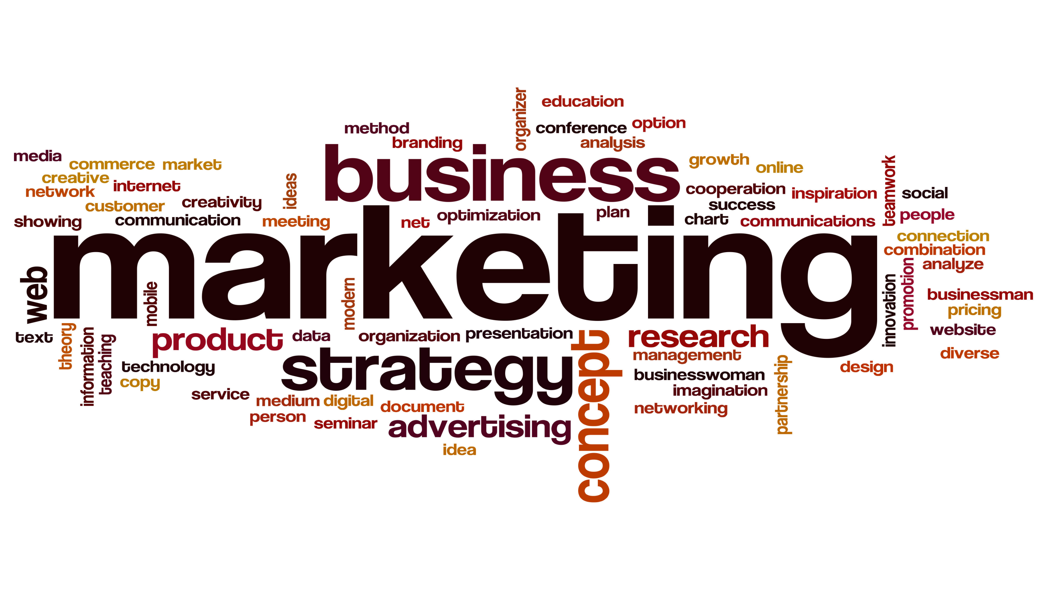

Slide 2
Lecture 0NE: Basics of Marketing Management

Slide 3
WHAT IS marketing?
Marketing is not only selling and advertising
Marketing is not a specialized activity at all; it encompasses the entire business
Marketing, more than any other business function, deals with customers
It is the whole biz seen from the point of view of the final result-the customer’s point of view
It is not just your product, price, promotion & distribution …
Marketing is the process by which companies engage customers, build strong customer relationships, create customer value to capture value from customer in return
Marketing is too important to be left with the marketing dept. only- David Packard

Slide 4
The marketing process
Understand the marketplace & customer needs & want

Slide 5
The marketing process
Understand the marketplace & customer needs & want
Design a customer value driven marketing strategy

Slide 6
The marketing process
Understand the marketplace & customer needs & want
Design a customer value driven marketing strategy
Construct an integrated marketing program that delivers superior value

Slide 7
The marketing process
Understand the marketplace & customer needs & want
Design a customer value driven marketing strategy
Construct an integrated marketing program that delivers superior value
Engage customers, build profitable relationships, & create customer delight

Slide 8
The marketing process
Understand the marketplace & customer needs & want
Design a customer value driven marketing strategy
Construct an integrated marketing program that delivers superior value
Engage customers, build profitable relationships, & create customer delight
Capture value from customers to create profits & customer equity

Slide 9
The marketing process
Create value for customers and build customer relationships
Capture value from customers in return
Understand the marketplace & customer needs & want
Design a customer value driven marketing strategy
Construct an integrated marketing program that delivers superior value
Engage customers, build profitable relationships, & create customer delight
Capture value from customers to create profits & customer equity

Slide 10
Step 1: Understand The Marketplace & Customer Needs & Want
Customer Needs, Wants, and Demands
Needs
Discussion 1:
Do marketers create needs?
Wants
Demands
Market offerings- Products, Services, and Experiences
Products
Services
Experiences
Some sellers suffer from Marketing Myopia
The one thing that every company should ask themselves is What business are we really in?

Slide 11
Step 1: Understand The Marketplace & Customer Needs & Want
Customer Value: a central marketing concept, primarily a combination of quality, service and price (qsp), the customer value triad.
Segmentation, Target markets, and Positioning
Markets: Consumer, Business, Global, Nonprofit and Government
Competition
Marketing environment
Supply chain

Slide 12
Step 2: Design a customer value driven marketing strategy
What customers will we serve?
How can we serve them best?

Slide 13
Marketing management orientations
The production concept
The product concept
Starting point
Focus
Means
Ends
The selling concept
Factory
Existing Prod.
Selling & promotion
Profits thru sales vol.
The Marketing concept
Market
Customer needs
Integrated marketing
Thru customer satisfaction

Slide 14
Marketing management orientations
The Holistic Marketing concept
Relationship marketing: customers, employees, partners, financial community
Integrated marketing: communications, product & services, channels, price
Internal marketing: Marketing department, Senior Management, Other departments
Performance marketing: revenue, brand & customer equity, ethics, environment, social

Slide 15
Step 3: Preparing an Integrated Marketing Plan & Program
Transforming the marketing strategy into action
Blend each marketing mix tools (4P’s) into a integrated marketing program
4Ps
Product
Place
Promotion
Price
Modern 4Ps
People
Processes
Programs
Performance

Slide 16
Step 4: Managing customer relationship & Capturing Customer Value
Customer Relationship Management (CRM)
Customer Value
Customer Satisfaction
Customer Relationship levels & tools
Customer Engagement in today’s digital & social media
Customer engagement marketing
Partner Relationship Management

Slide 17
Step 5: Capturing value from customers
Creating Customer Loyalty & Retention
Growing share of Customer
Building customer equity

Slide 18



The Changing Marketing Landscape
The Digital Age:
Online marketing
Mobile marketing
Social media marketing
Rapid globalization
Sustainable marketing: The call for more environmental & social responsibility

Slide 19
Collecting information and forecasting demand
Marketing intelligence: procedures and sources used by managers to obtain everyday information about developments in the marketing environment
Reading books, newspapers, trade publications
Talking to customers, suppliers, distributors, and other company managers
Monitoring online social media
Analyzing the Macroenvironment
Needs and trends
Identifying major forces
Environment: Demographic, Economic, Sociocultural, Natural, Technological, Political Legal

Slide 20
Collecting information and forecasting demand
Demand measurement
Estimating current demand: total market potential, area market potential, total industry sales and market share
Estimating future demand: Buyers’ intention survey, composite of sales force opinion, expert opinion, past-sales analysis, market-test method

Slide 21
Thank you

